Slide 1
A
Presentation
on
E-Adhyapan
at
Bhilai Institute of Technology
Affiliated to
Chhattisgarh Swami Vivekananda Technical University, Bhilai(CG)
Durg
2022
Submitted By:
Vikrant Sahu &
Kumari Mausham

Slide 2
List Of Contents
Introduction
Objective
Project’s Process Documentation
Inception Phase
Elaboration Phase
Construction Phase
Transition Phase
Screenshot Samples
Conclusion

Slide 3
INTRODUCTION
A “E-Adhyapan” portal project that acts as an online portal between students and the admin.
The system is designed for a Students who are in interested to study online.
It contains an admin who can enter details.
Student can register their id. Students can then login and ask Question When students login they can see their Previous Asked Question and also a download page where students may download pdf format Ebooks or Notes from the web system

Slide 4
Objective
The main objective behind construction of this portal is to provide a single place to students from where they can do all the study related activates without login to different websites.

Slide 5
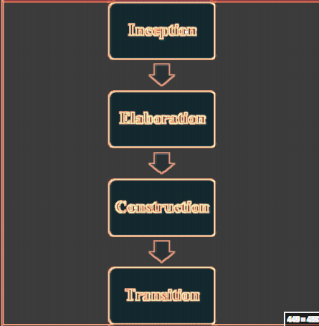
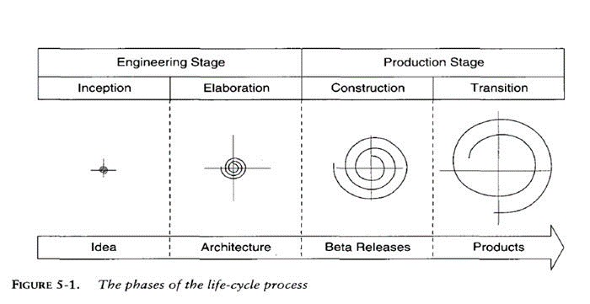
Project Development Process Model
We will use modern software development process model to create website record maintenance system, modern software development process model is an iterative process model in which all phases of software development like inception, elaboration, construction and transition will be used. We will not jump to the next phase until we complete the present phase.

Slide 6
Project’s Process Documentation
Inception Phase
Establish the Project Scope
Software Requirement Specifications (SRS)
Security Feature
Reliability
Cost Estimation using DFP
Elaboration Phase(Detail Design)
Construction Phase
Transition Phase

Slide 7
Scope
There are also few features which can be integrated with this system to make it more flexible. Below list shows the future points to be consider.
The objective is to develop an Online Portal System to promote and encourage students
Our project replaces the conventional and inconvenient method of clearing doubts in classes which involves the mentor and student to be physically present at the same time.
In this context arises the importance of our project. This project bridges the existing gap between mentor and students due to the time constraints.

Slide 8
Advantages
E-Adhypan offers unique advantages over conventional methodologies:
Easy to understand and operate.
Stores and manages the data.
Monitors the information.
Shows the information.

Slide 9
Software Requirement Specifications (SRS)

Slide 10
SOFTWARE SPECIFICATION
Front end :-- HTML + CSS (+Bootstrap)
Back end :-- (Django) Python
Operating System: Window XP, Vista, 7, 8, 8.1, 10,11
Programming Language:-- Python,+ Html,+ CSS(+bootstrap)

Slide 11
HARDWARE SPECIFICATION
Processor :- Intel(R) Core (TM) i3-4210U CPU @1.70GHz
RAM :- 8.00 GB
Hard Disk :- 20 GB
Keyboard :- Normal or Multimedia
Mouse : - Compatible Mouse

Slide 12
Security Features:
Front-End Security
Security API’s
Cryptographic Security
Exception Handling
Back-End Security
Database Password
Workgroup Security

Slide 13
Elaboration Phase
(Detail Design)

Slide 14
Object Class
Object Model
As per the requirement describe in the SRS we have following class object name and their description/purpose as given as following table-1
Sr. No | Name of Object/Classes | Description
1 | Login Page | Used to provide authentication and validation.
2 | Home | Used to provide all task to move from the homepage to the destination task page.
3 | Contact Page | Used to provide to fill the require record and save it into the database.
4 | Notes page | Page where all document provided by admin are available.
5 | Video page | Page where all the video contents are available.
6 | Admin Dashboard | Used to provide all task to move from the homepage to the destination task page.

Slide 15
Modules
Main modules of E-Adhypan are related to:
Administrator Module
User Module
Videos Module
Notes Module
Registration Module
Contact Module
Ask Question Module
Authentication module

Slide 16
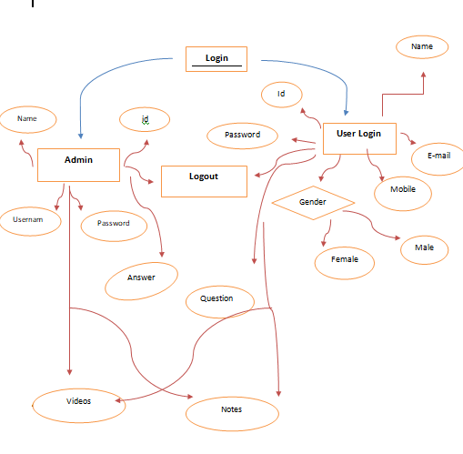
ER-Diagram

Slide 17
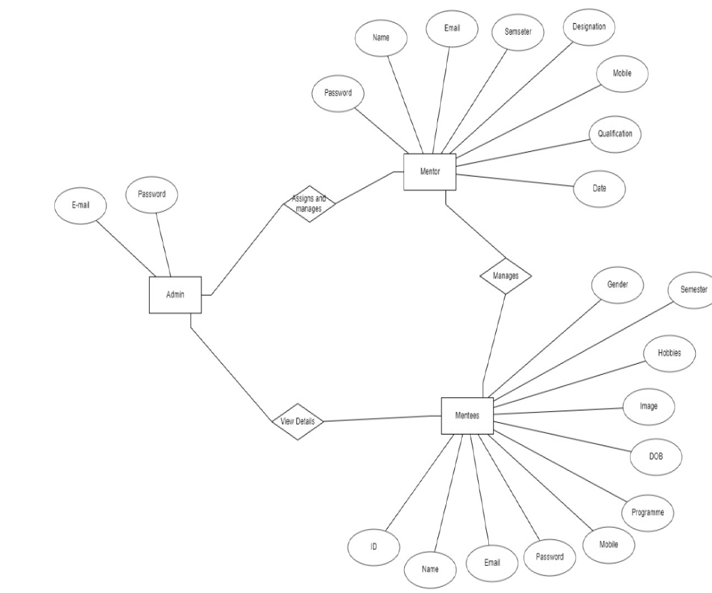
Database Design

Slide 18
Construction Phase

Slide 19
Case Tool : Visual Code(for Design)
Coding Language : Python , Html, CSS
Operating System : Windows
Database Connectivity Procedure: SQL lite

Slide 20
Screenshot Samples

Slide 21
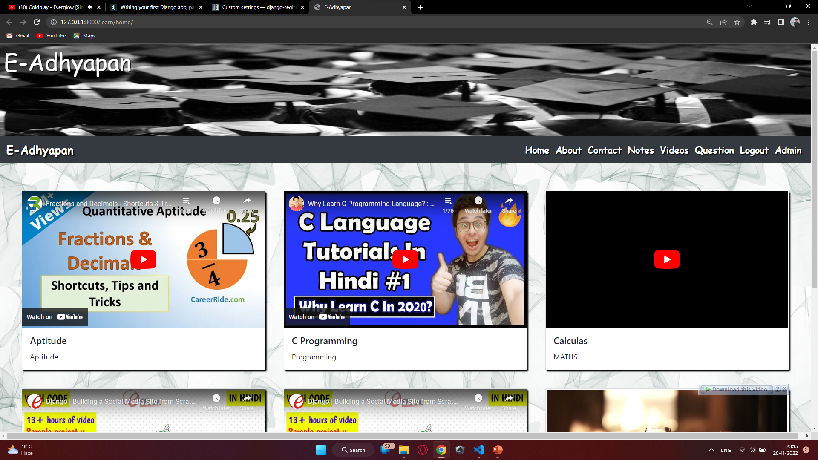
HOME PAGE

Slide 22
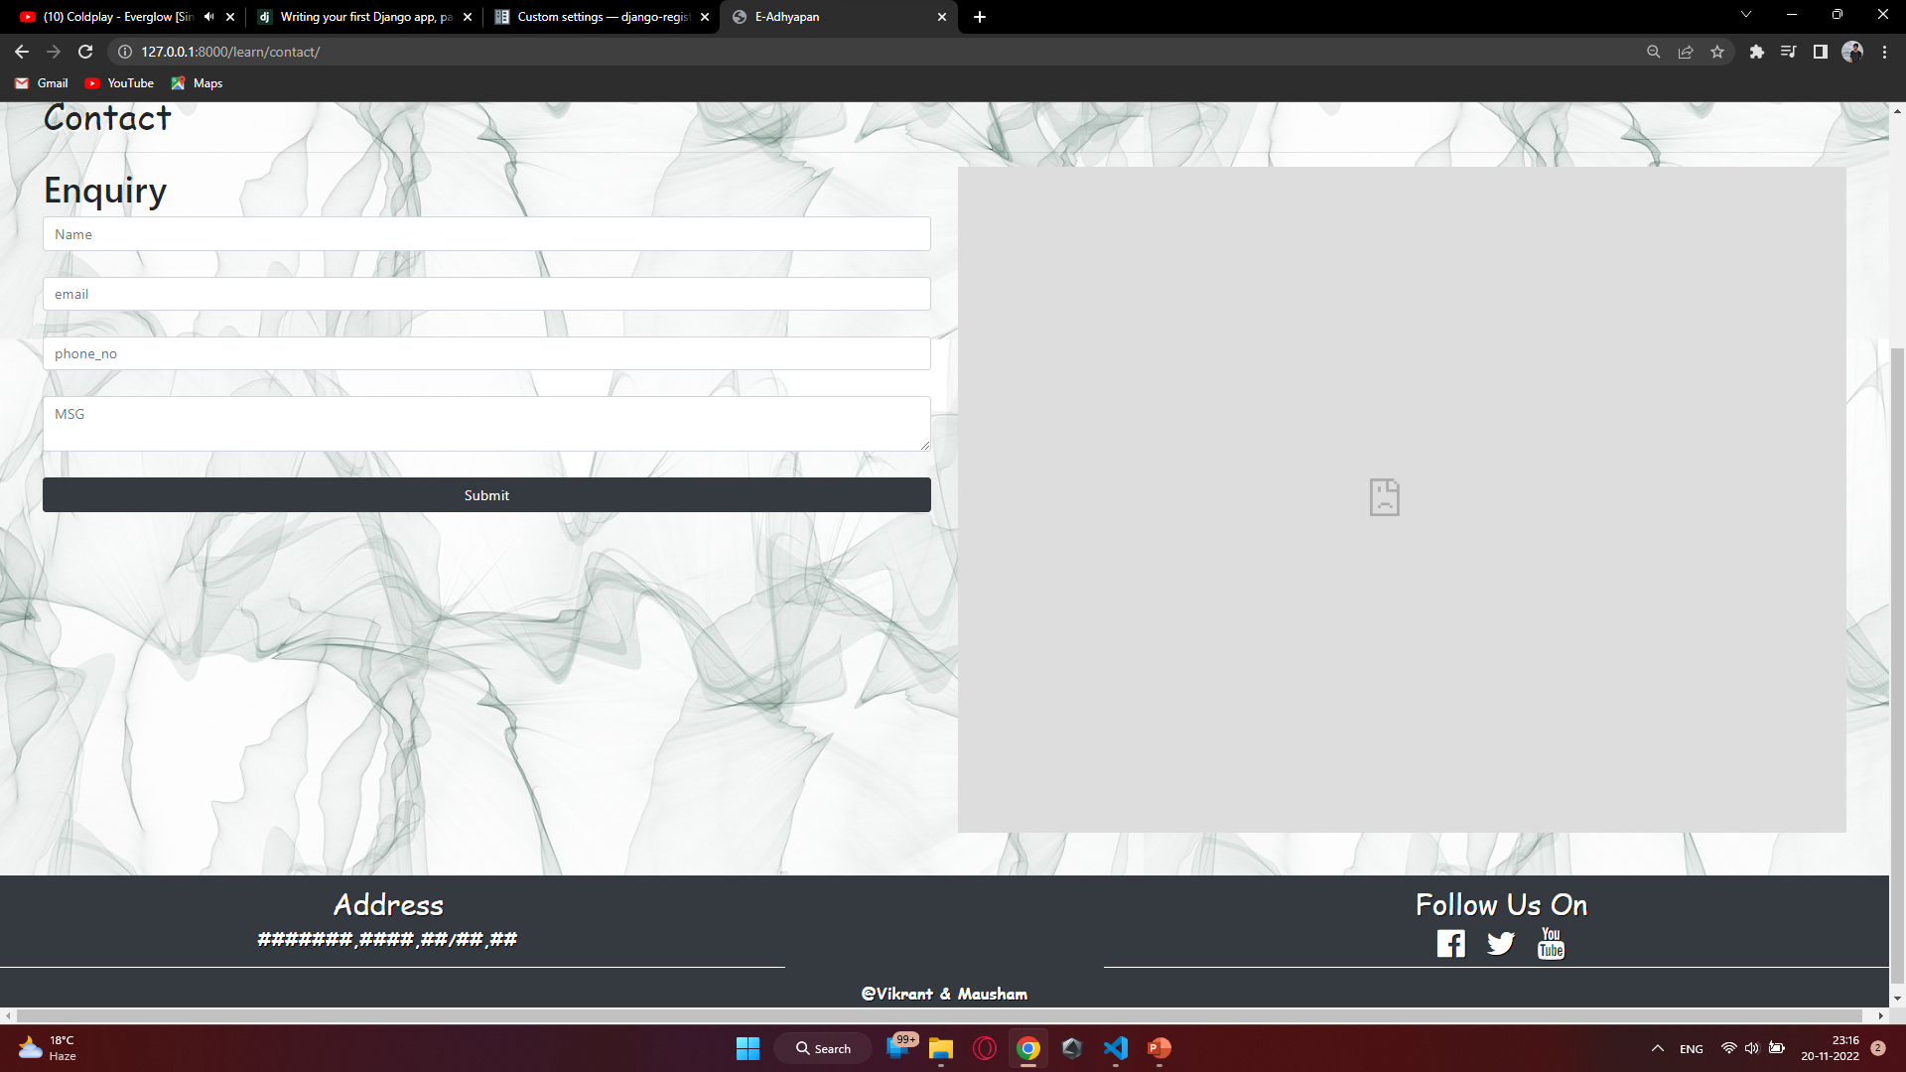
Contact

Slide 23
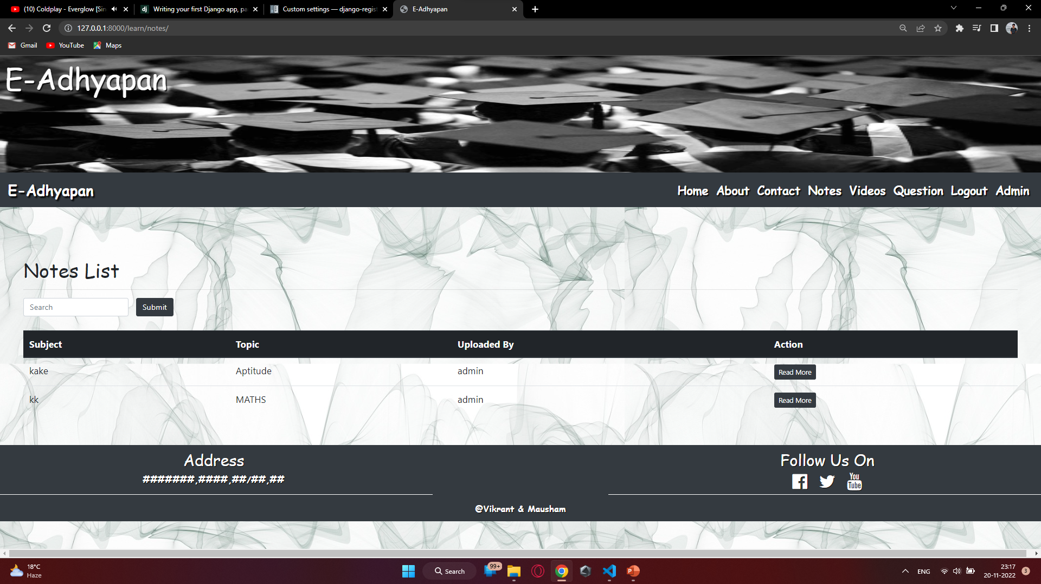
Notes

Slide 24
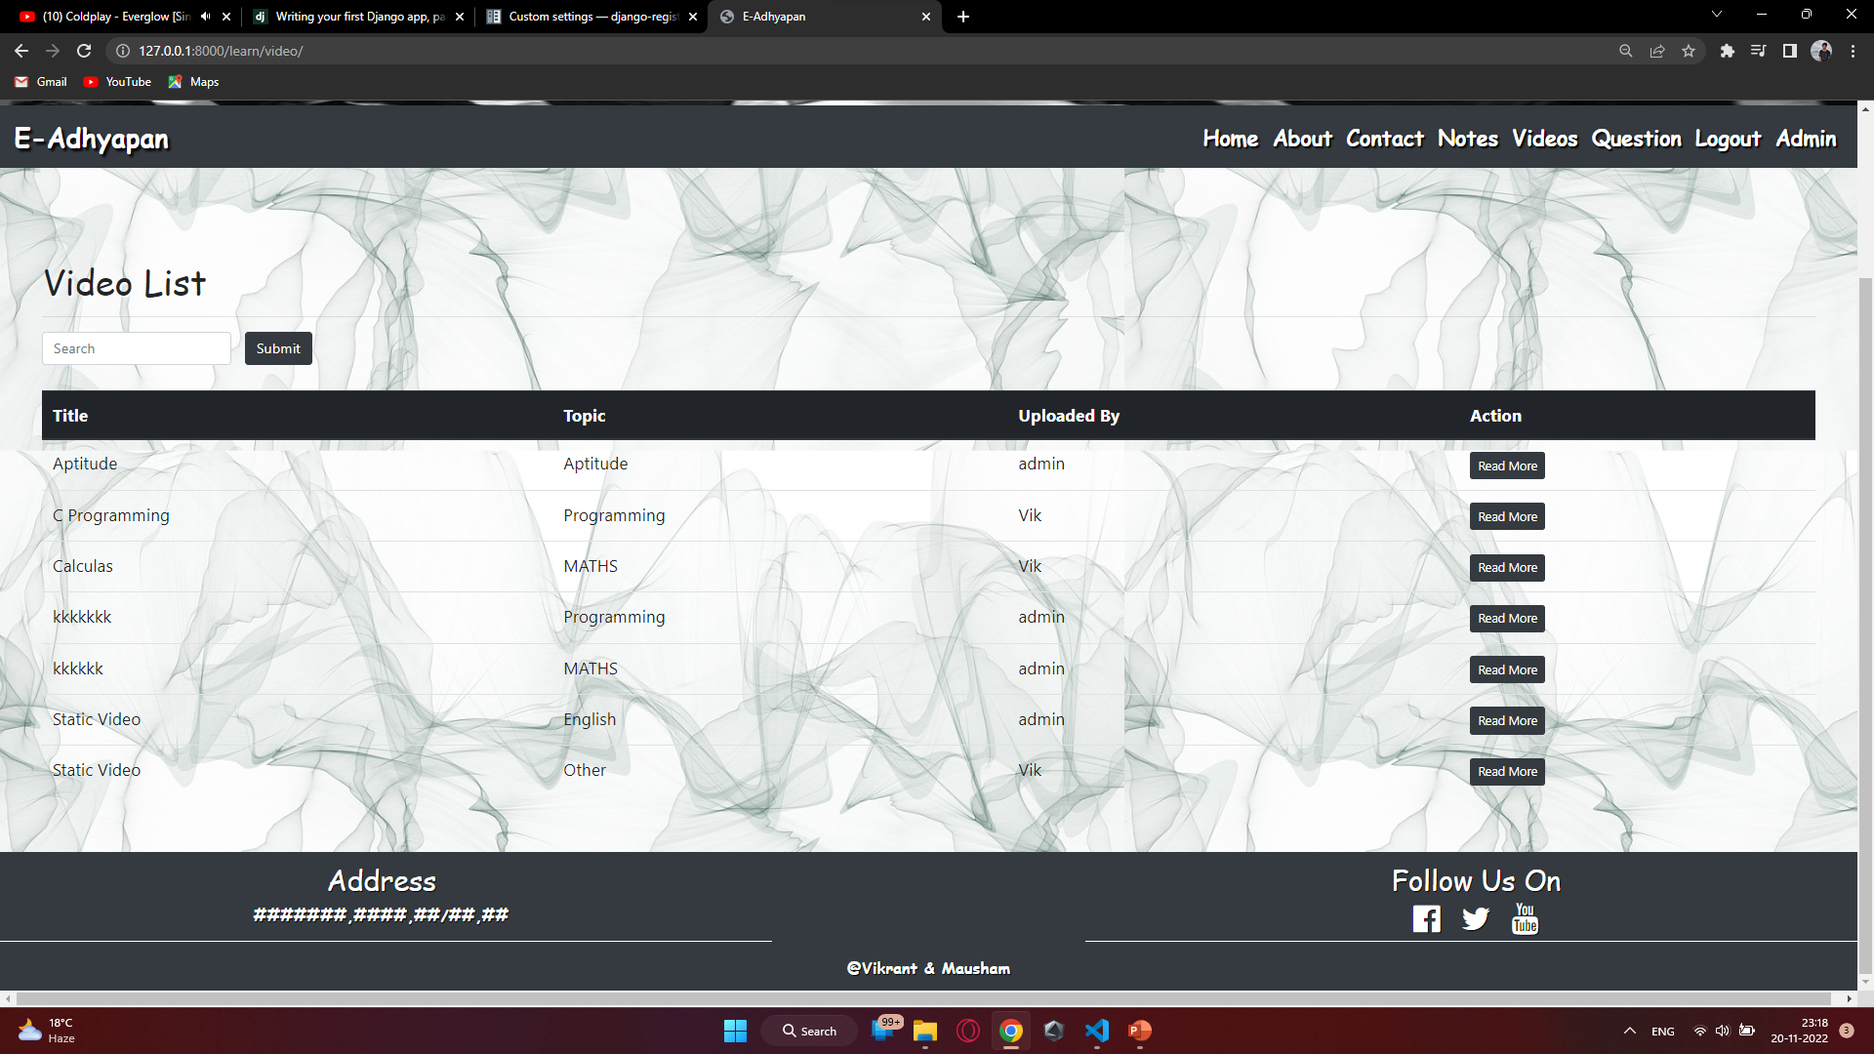
Videos

Slide 25
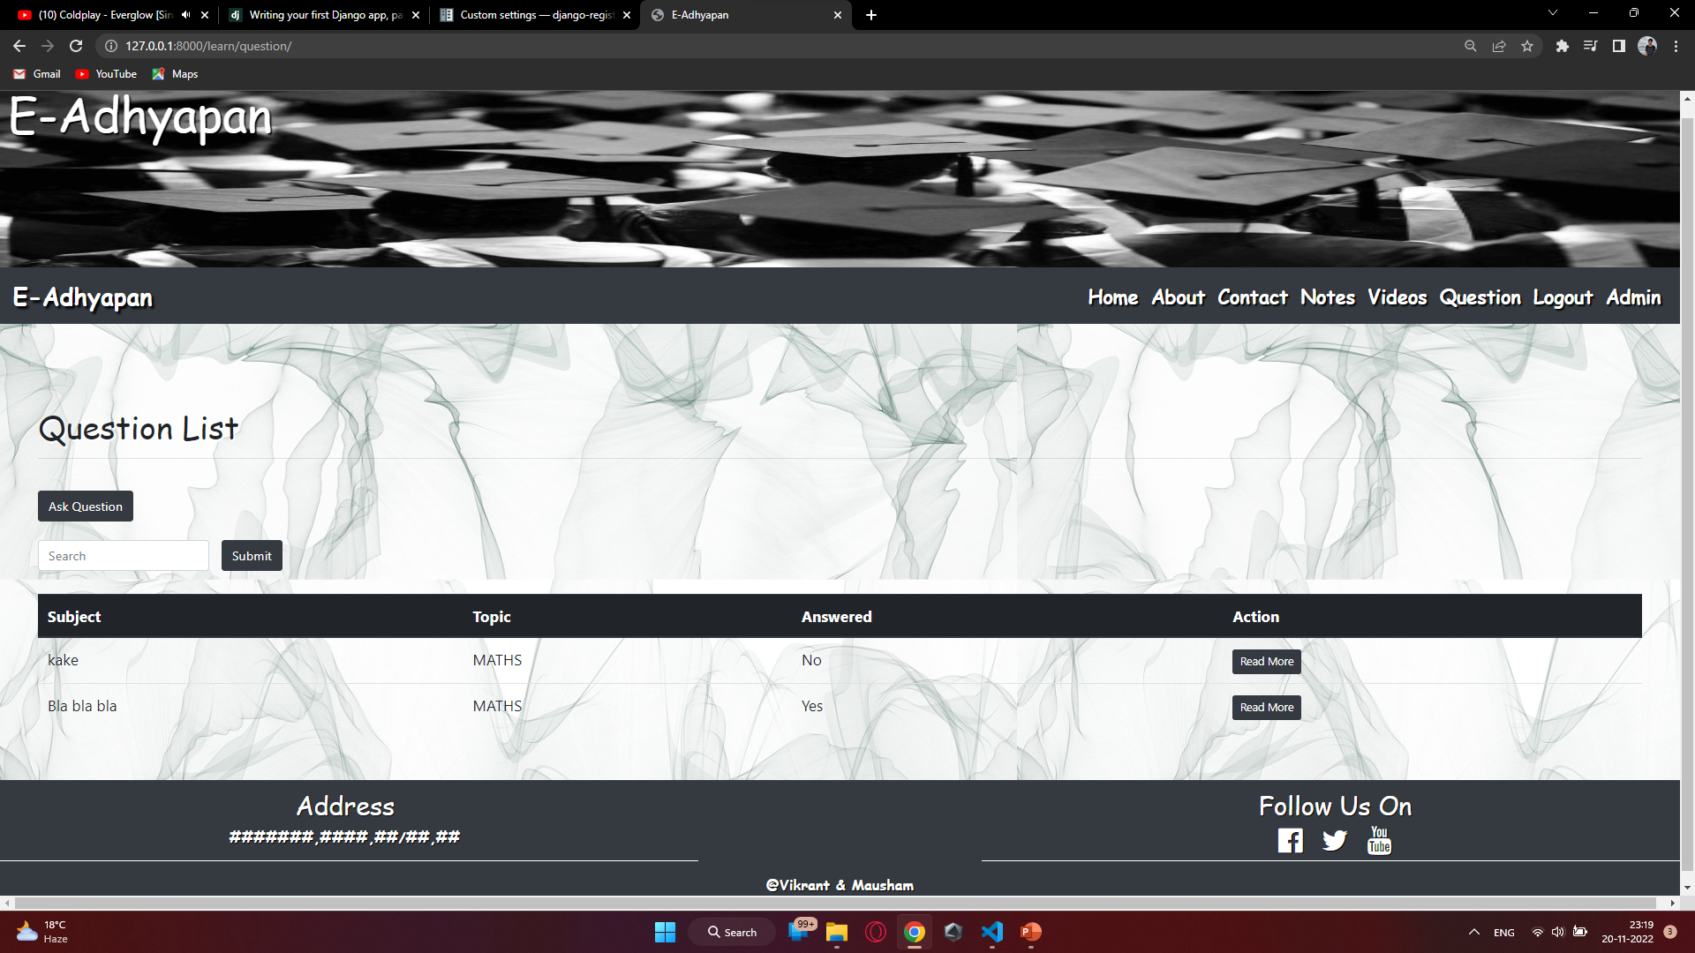
Question

Slide 26
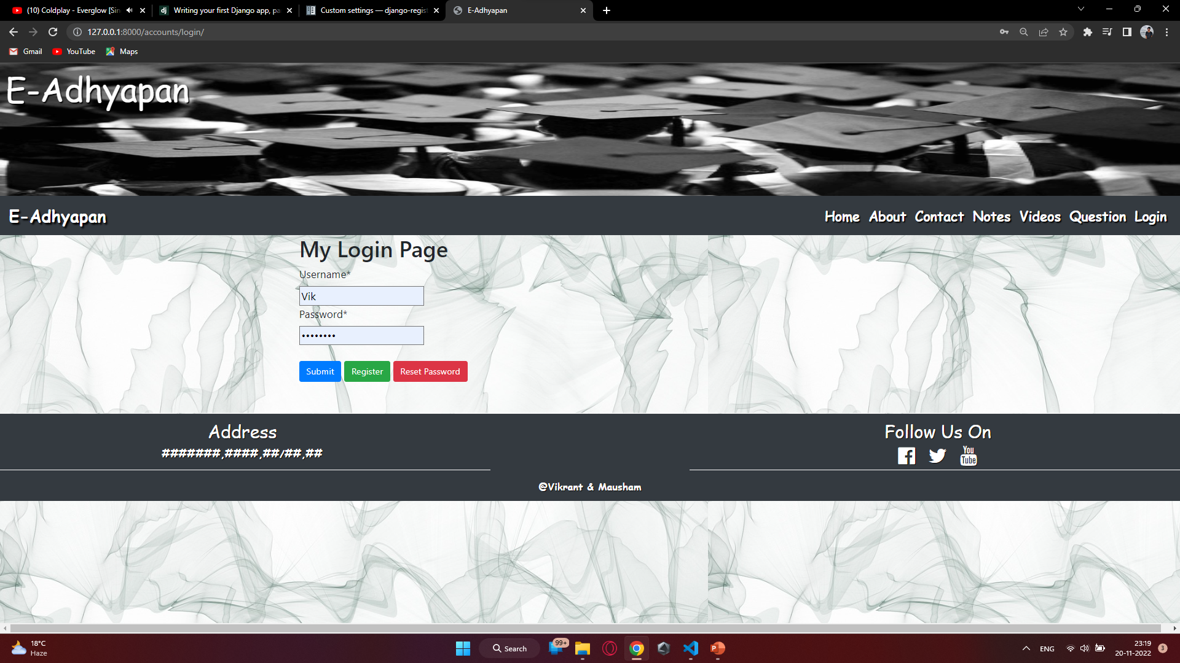
Login

Slide 27
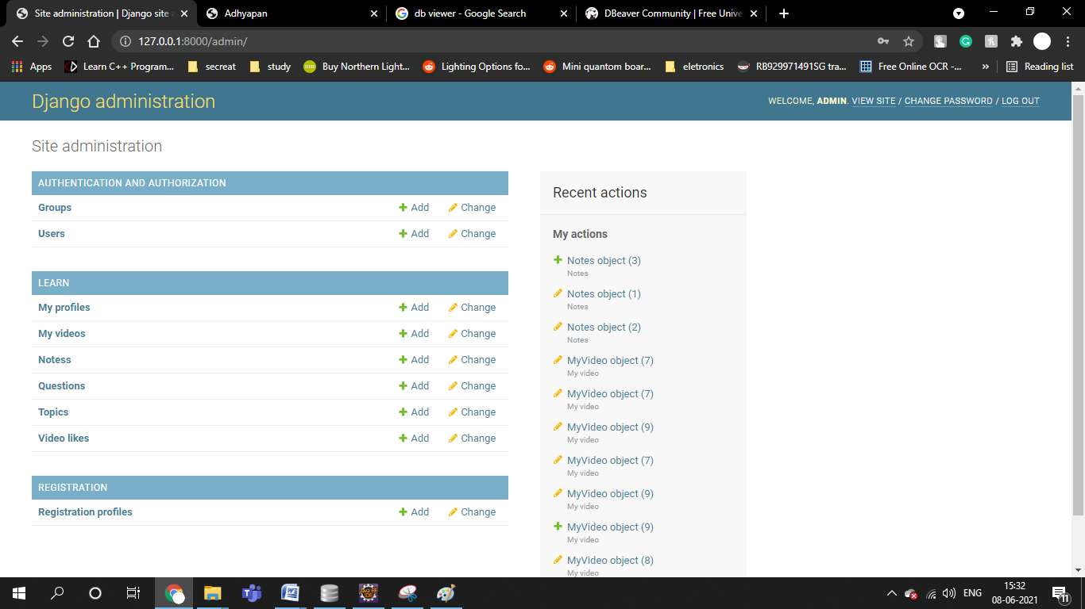
Admin Dashboard

Slide 28
CONCLUSION
The E-Adhyapan is mainly used to share the views between the users of the application which is very useful to upgrade the knowledge of everyone. The application is also serve as a useful site to know what is going on and can also know about the various opportunities of the outer world. The application can be further expanded by following the future Enhancements mentioned above.
The above features the detailing , description and facilities from E-Adhyapan.
The addition .deletion ,and modification of various details for various forms like user details , notes details, etc.
This project are very user friendly , simple and easy , it aimed at overcoming the shortcoming of manually operated system.

Slide 29
Thank you
BY :-
Vikrant Sahu & Kumari Mausham

